Slide 1


Wavelet-Driven Recurrent Neural Networks for Short Term Load Forecasting
Presented by Pouya Irani
Supervisor:
Prof. Danilo Comminiello
Master of Science in Control Engineering
Department of Computer, Control and Management Engineering
July 2023

Slide 2
Contents
Introduction:
Motivation
Contribution
Load forecasting classification
Litreture Review
Recurrent Neural network
Transformers
Wavelet transform
Methodology
multilevel Wavelet Decomposition Network (mWDN)
Experiments and results
Conclusion

Slide 3
Introduction

Slide 4
Introduction
Motivation:
Short-term load forecasting (STLF) is crucial for estimating future loads in electrical power networks.
Accurate STLF enables efficient management of energy supply and demand.
Credible prediction intervals (PI) are essential for evaluating risk and making informed decisions.
Precise PIs in real time ensure load management efficiency and power grid stability.
Challenges:
Overcoming obstacles for effective short-term load forecasting.
Capturing frequency components and incorporating them into forecasting models.
Addressing data collection inconsistencies and errors.
Deriving prediction intervals in real time, considering statistical properties and potential errors.
Contribution:
Preparing deep learning models for time series prediction
Employing the wavelet transform for our purpose
Createing frequency-aware deep learning model
Notes:
4

Slide 5
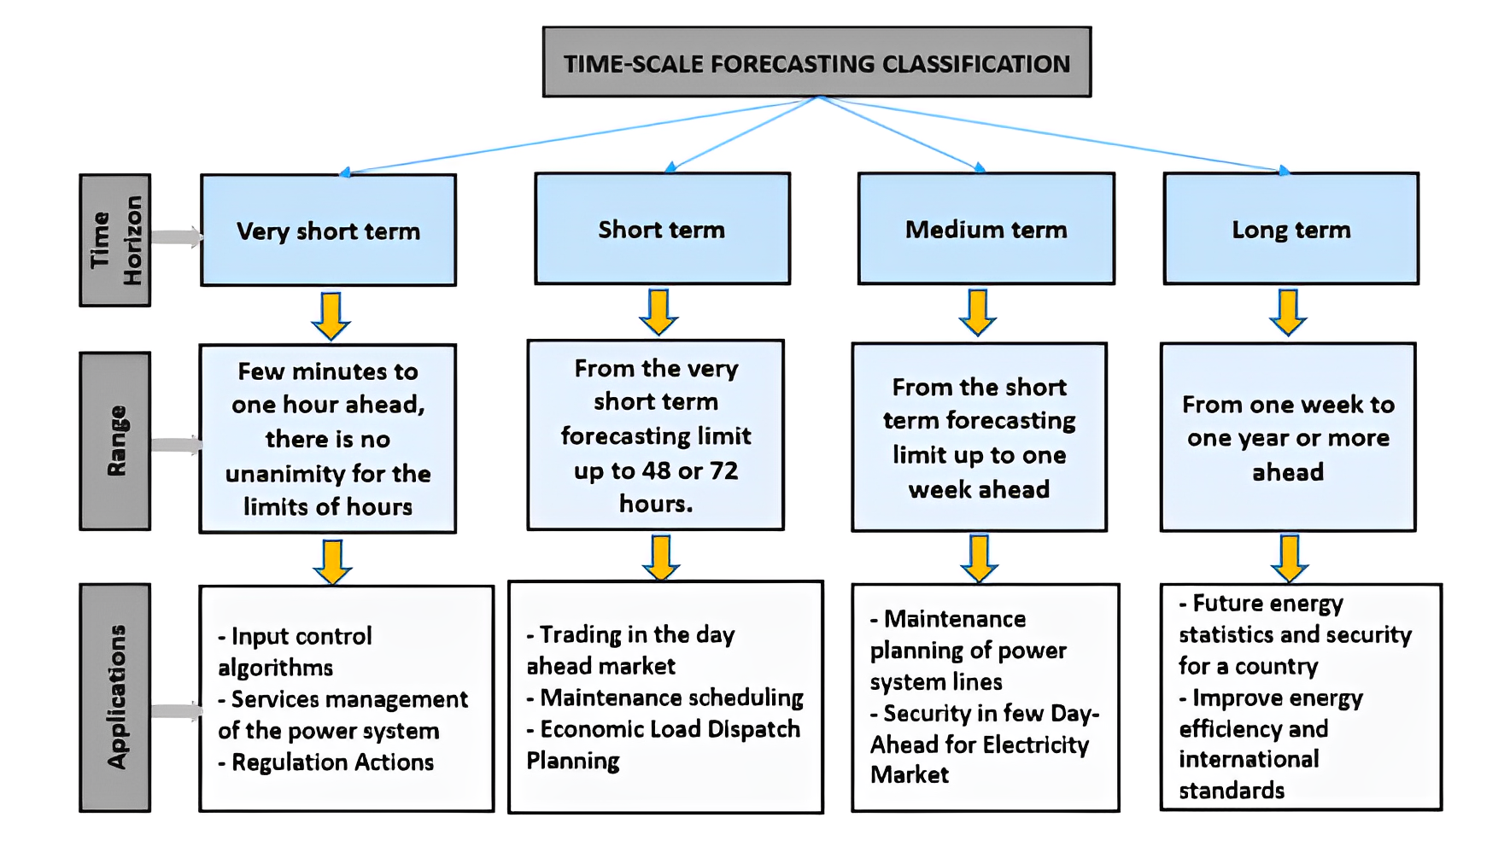
Time scale forecasting classification

Slide 6
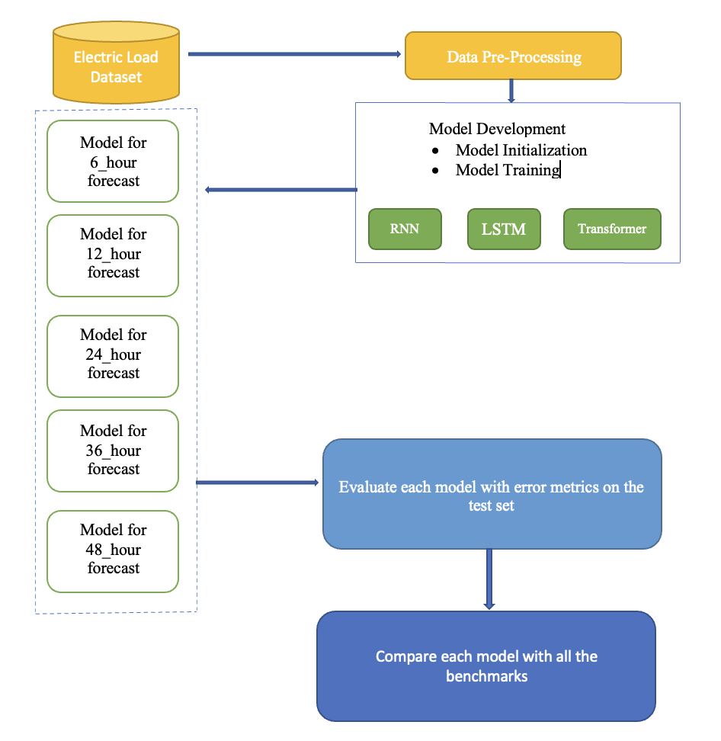
Short-Term Load Forecasting Methods

Slide 7
Literature Review

Slide 8
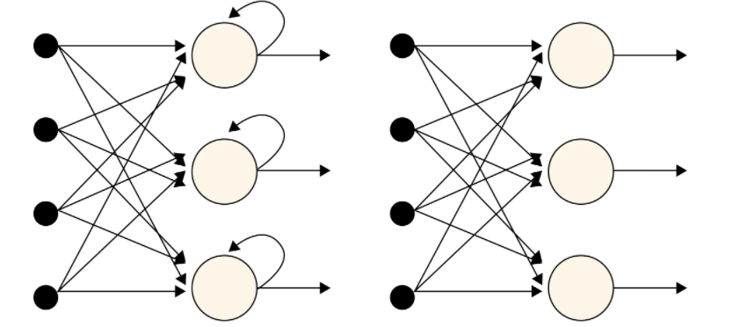
Recurrent Neural Network
RNNs are designed for sequential data and adapted for time series forecasting.
RNNs utilize previous outputs along with current input data for predictions.
RNN model architecture includes layers and units, with hidden layers maintaining the input's history.
Hyperparameters like the number of layers, units, and learning rate impact RNN performance.

Slide 9
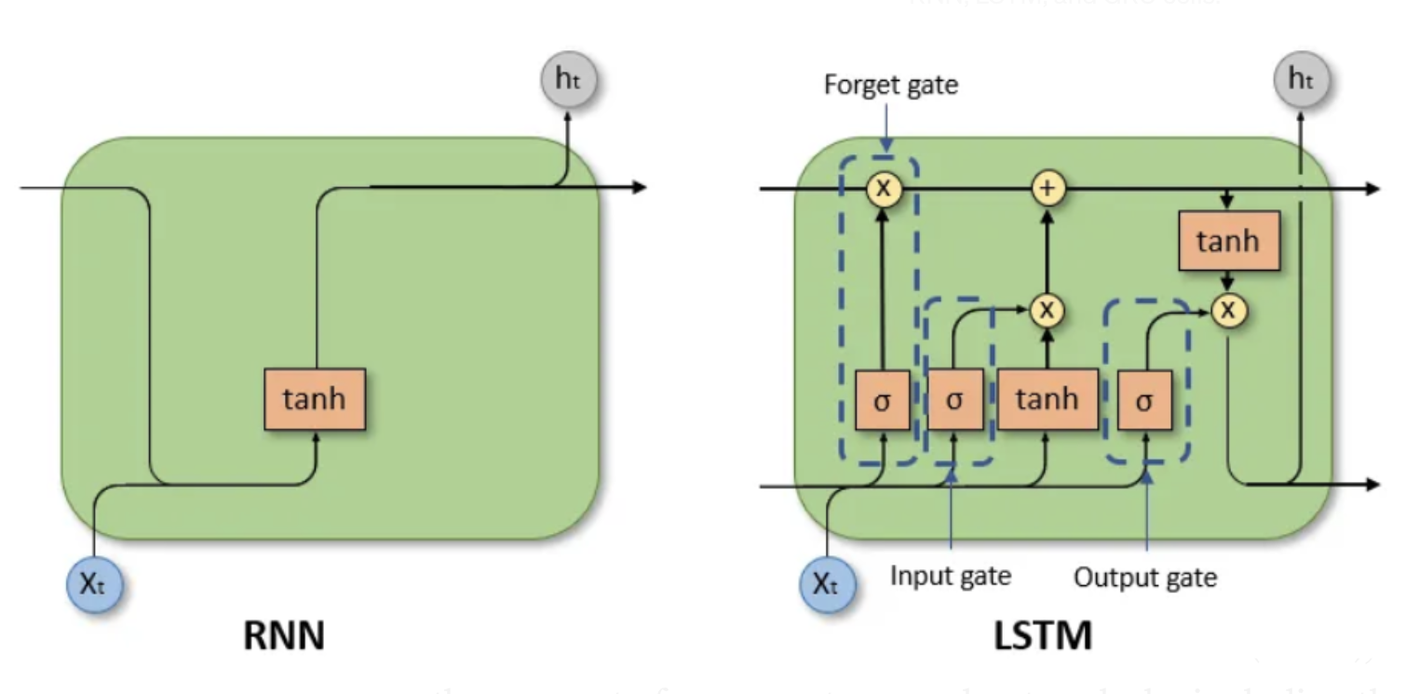
Long Short-Term Memory
LSTM is a gated neural network, memory unit designed for long-term dependencies.
It has input, forget, and output gates that control memory content and recall.
LSTM networks outperform traditional recurrent neural networks in time series forecasting.

Slide 10

Roadmap of Transformers for Time-Series Analysis
The Transformer model, initially designed for natural language processing, has been adapted for time-series analysis.
Specific modifications and enhancements have been made to address the challenges of time-series data.
The encoder-decoder structure with self-attention and feed-forward networks provides a powerful framework for capturing dependencies and generating predictions.
Positional encoding, attention mechanisms, and multi-head processing are integral components of the Transformer model for time-series forecasting.
Transformers have shown promise in time-series classification, forecasting, anomaly detection, and semantic segmentation.

Slide 11
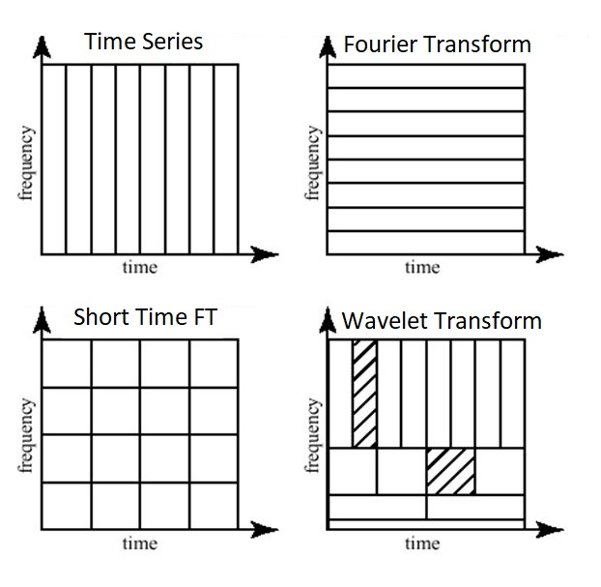
Fourier Transform vs Wavelet Transform
Fourier transform (FT) is a representation of a signal in terms of sinusoids.
FT provides a signal which is localized only in the frequency domain.
No information of the signal in the time domain.
Wavelet Transform contains the information of the signal both in time and frequency domain.
The wavelets are scaled and translated copies known as "daughter wavelets" and "mother wavelet“.
Notes:
Discrete and continuous wavelet

Slide 12
Methodology

Slide 13

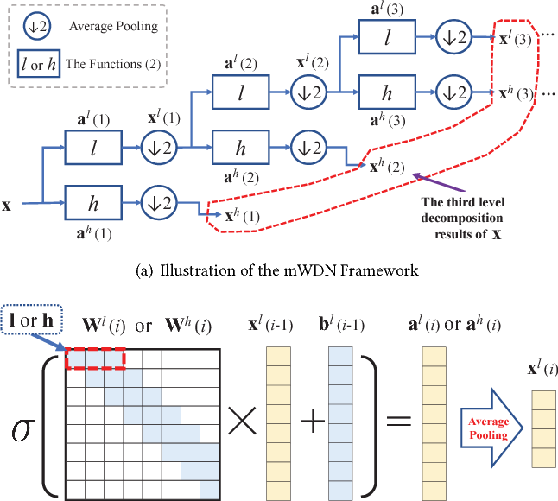

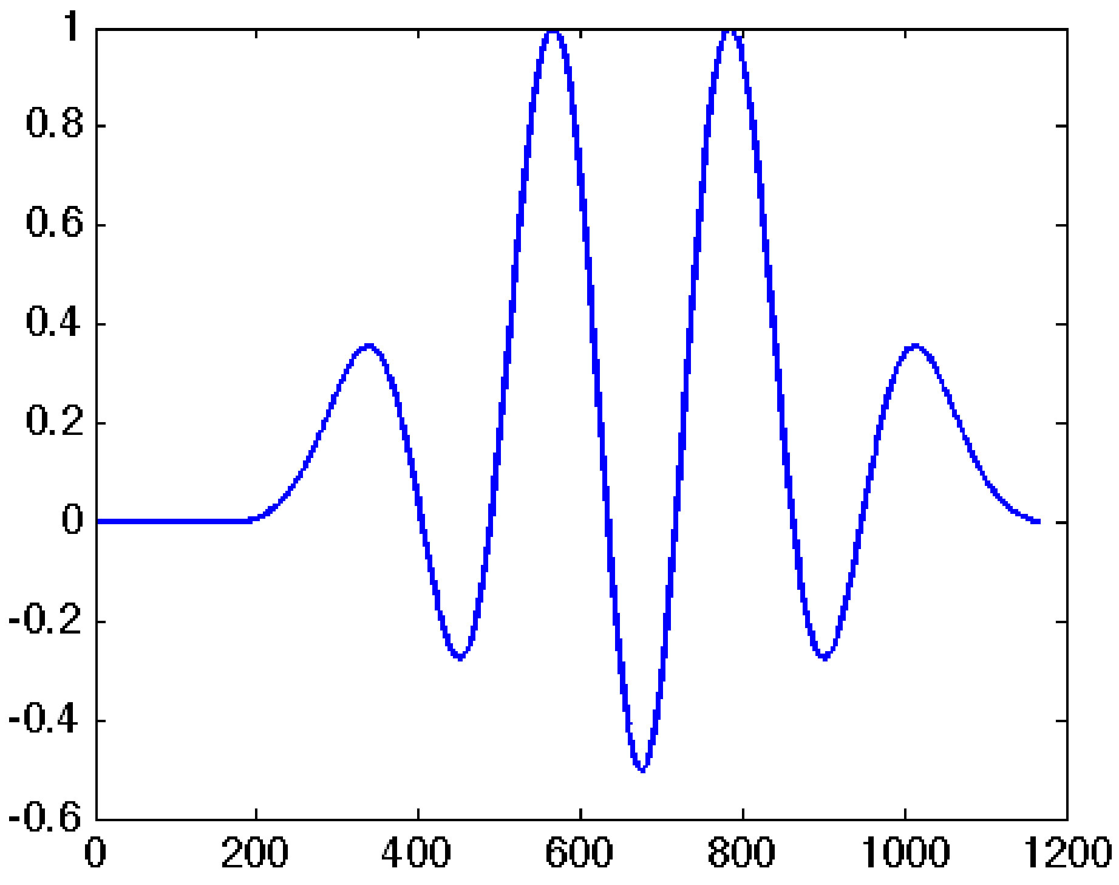
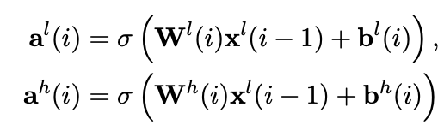
Multilevel Wavelet Decomposition Network

Slide 14
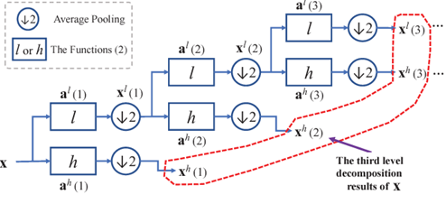
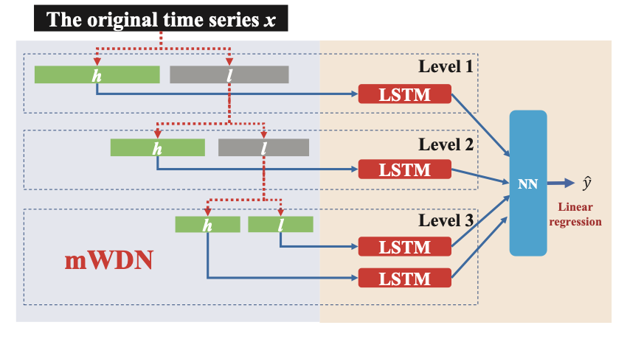
Multi Frequency Long Short Term Memory (LSTM)

Slide 15
Advantage of WLSTM
Explores and exploits frequency-time relationships
Enables comprehensive and accurate forecasting model
Decomposition into different frequency components. captures underlying patterns and correlations at various scales
Enables robust predictions for complex and dynamic time series
Provides insights into the importance of frequency components

Slide 16
Experiments & Results

Slide 17
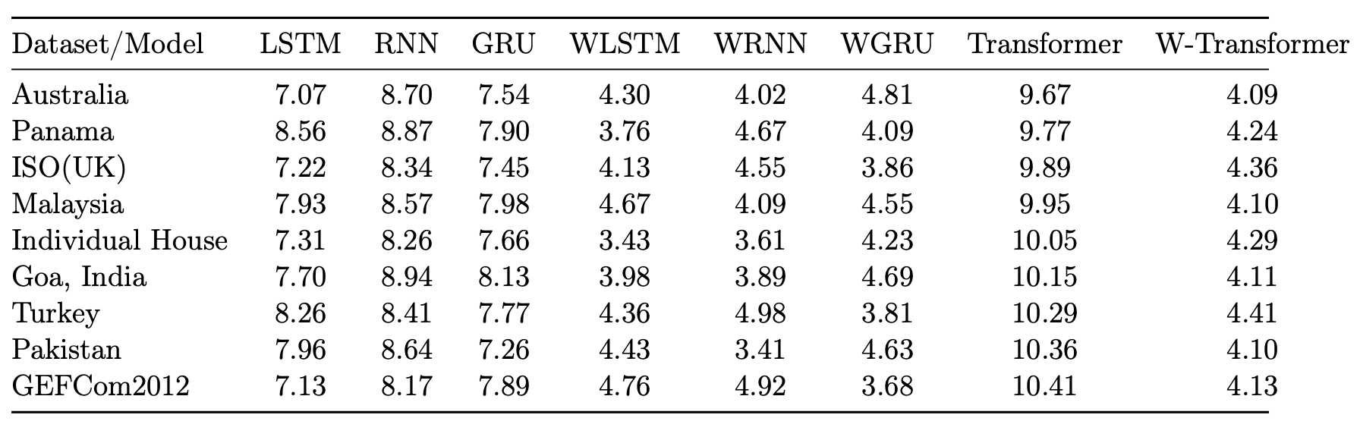
Experiment and Results
Mean Absolute Percentage Error

Slide 18
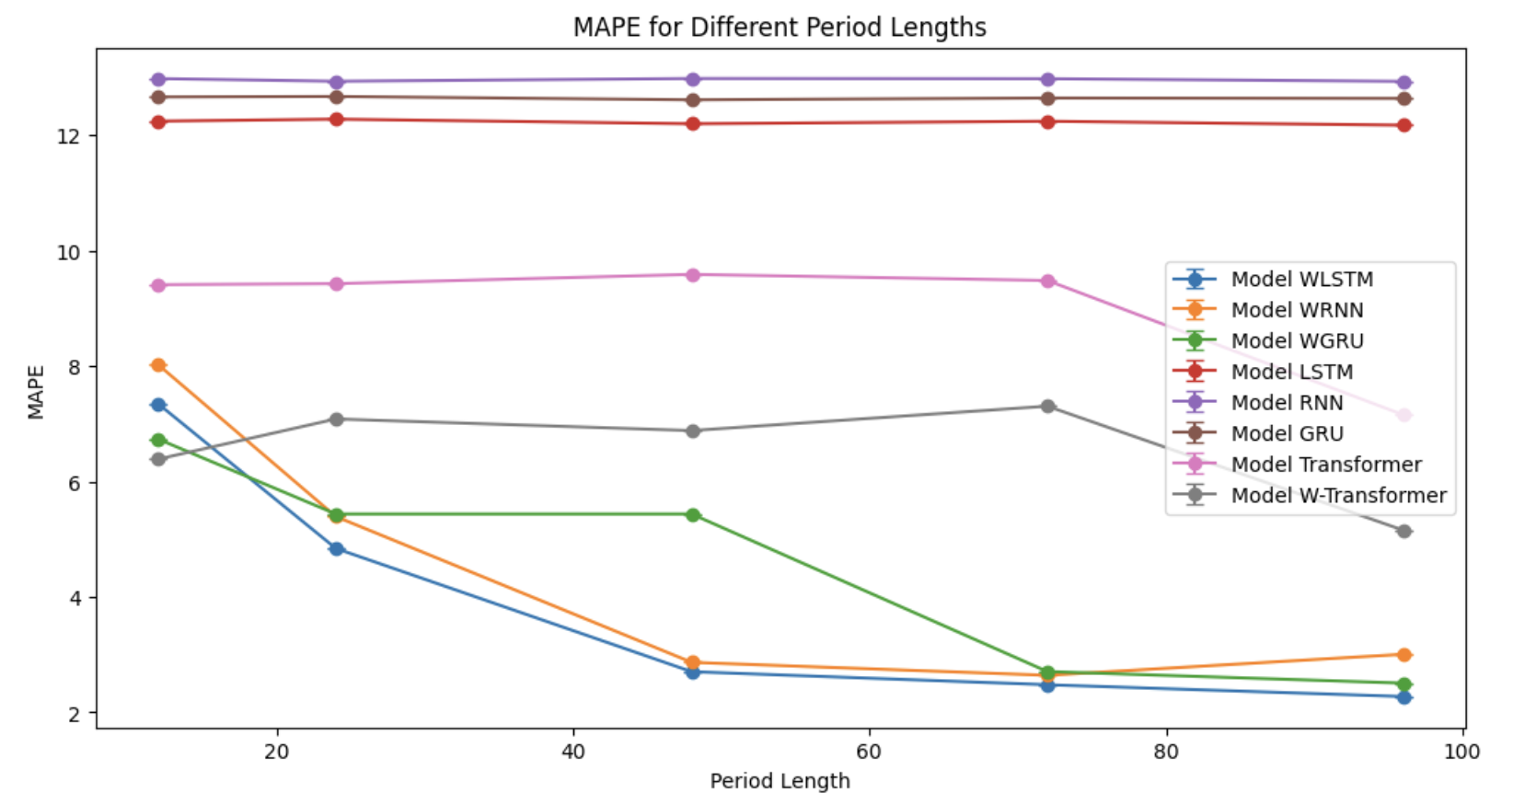
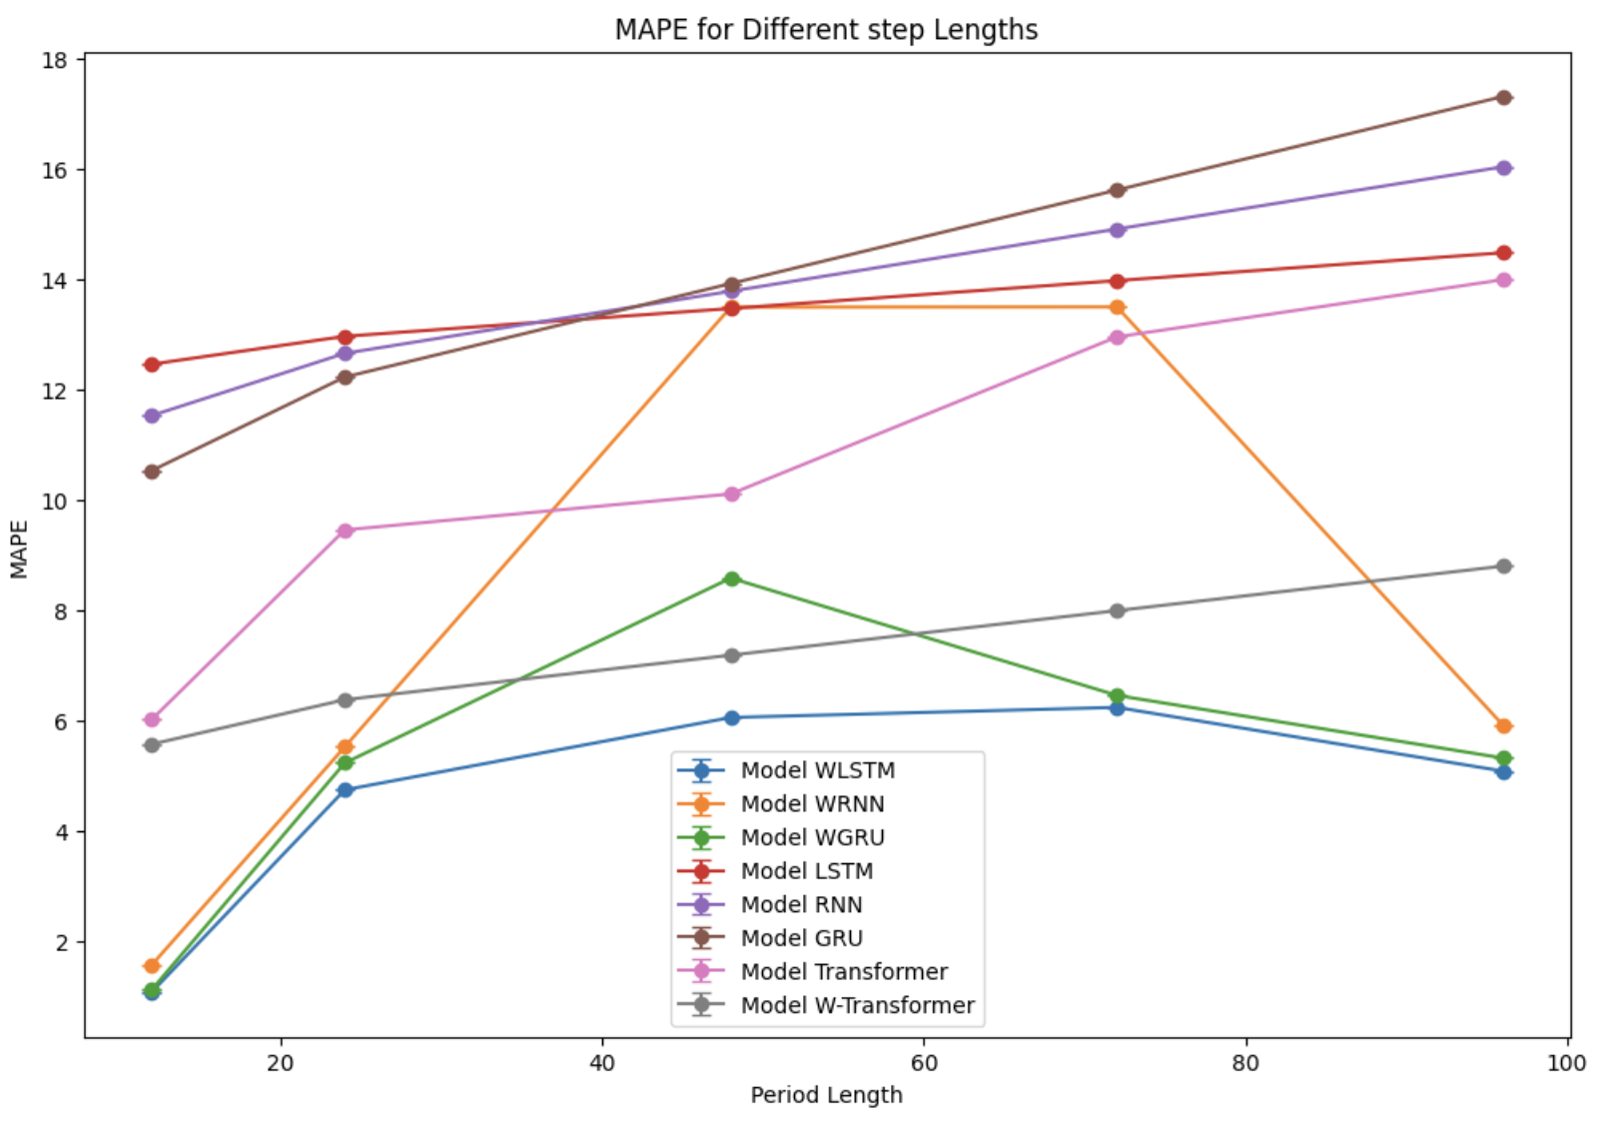
Training sequence and forecast horizon variation
Scenario 1: Varying Training Series Length:
Investigated the effect of changing training series length.
Ranged from 12 samples to 96 samples at different time intervals.
Scenario 2: Adjusting Prediction Sequence Length:
Examined the impact of varying the length of the prediction sequence.
Ranged from one sample to twenty-four samples.
Baseline
MWDN

Slide 19
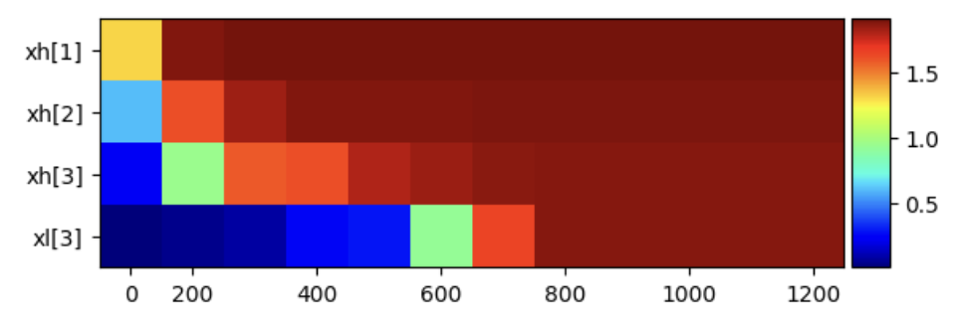
Frequency importance spectra
Lower frequency layers exhibit smaller importance, while higher frequency layers capture precise time value.
Crucial role of high-frequency layers in achieving accurate time series forecasts.
Short-term patterns are encapsulated in high-frequency information, while long-term trends are typically captured in low-frequency layers.

Slide 20
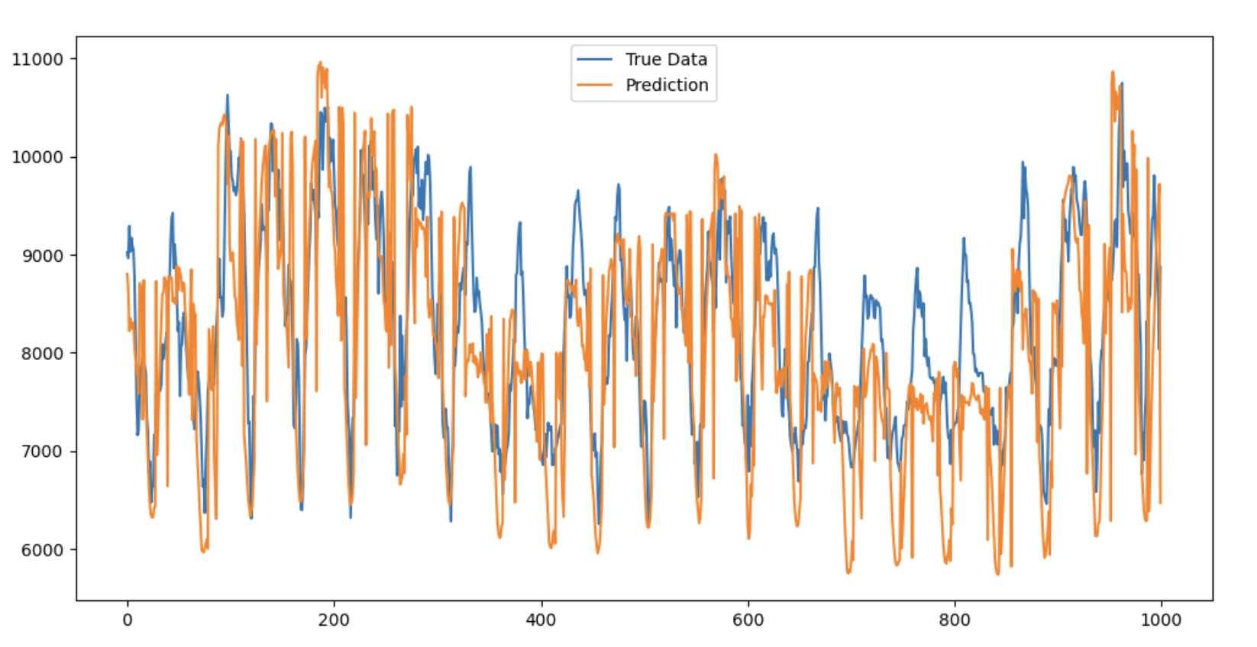
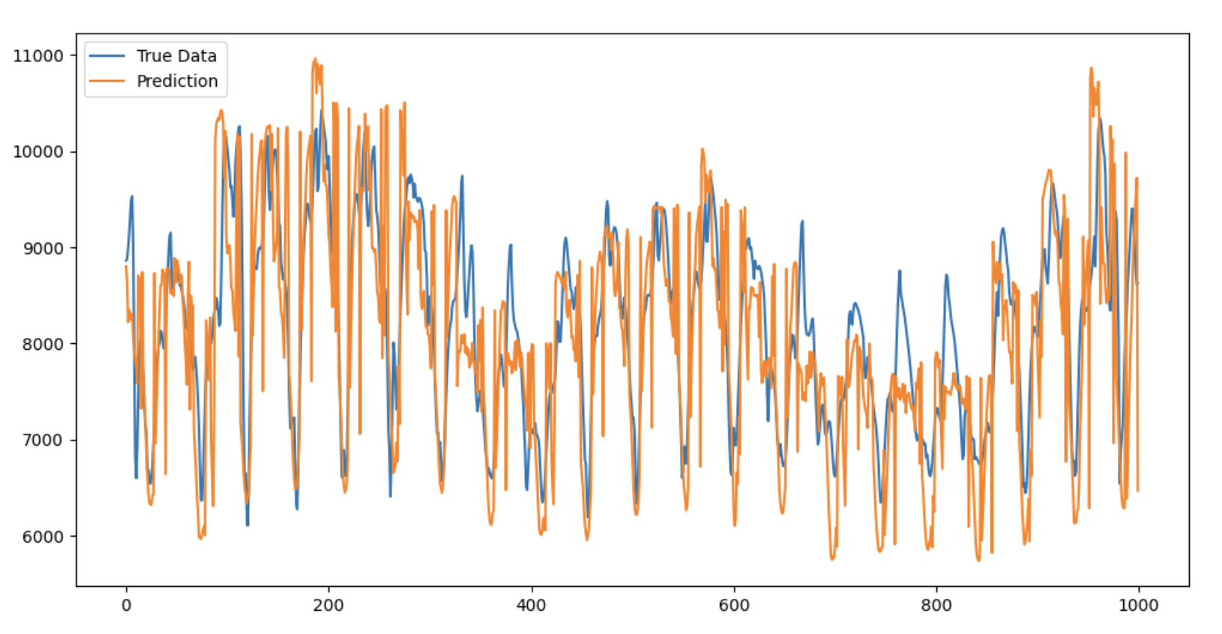
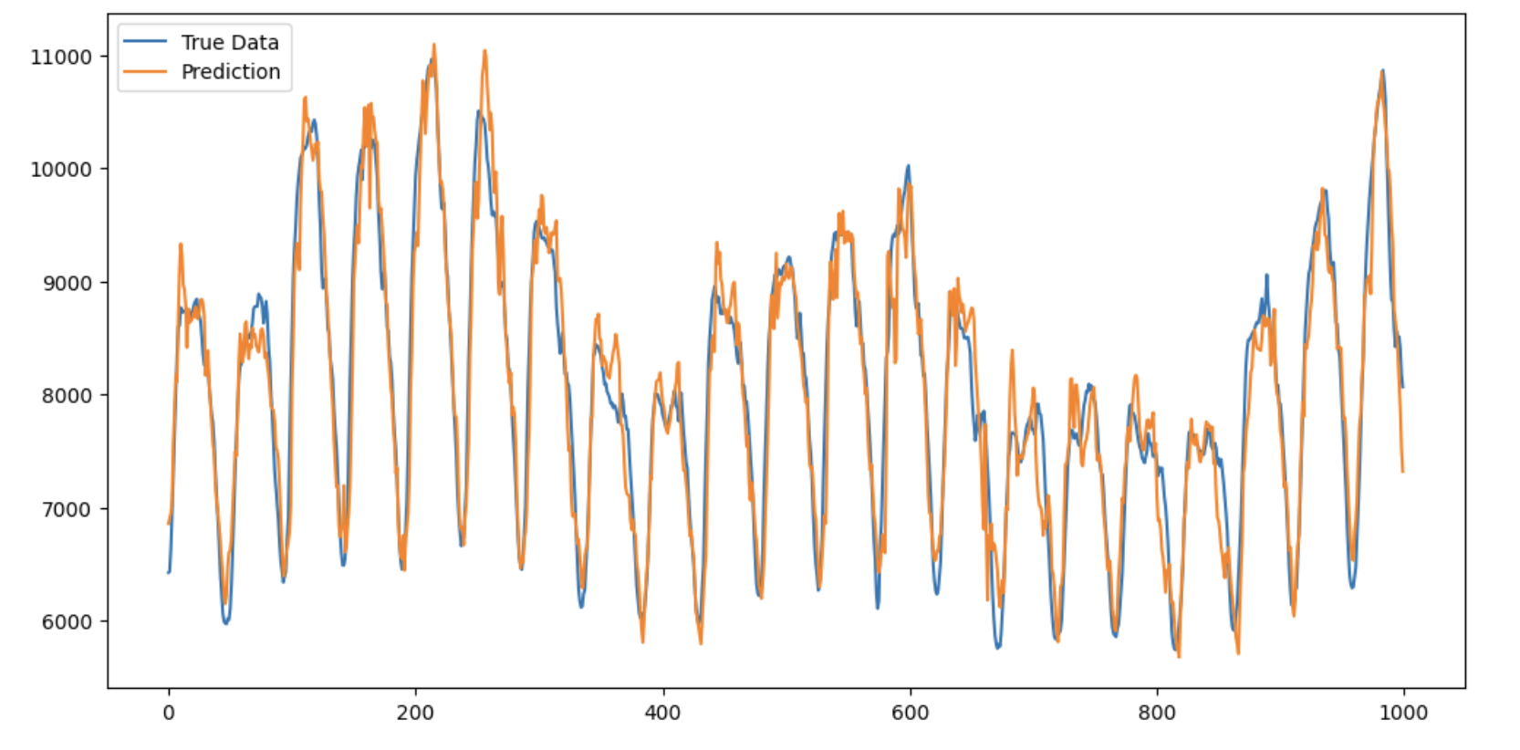
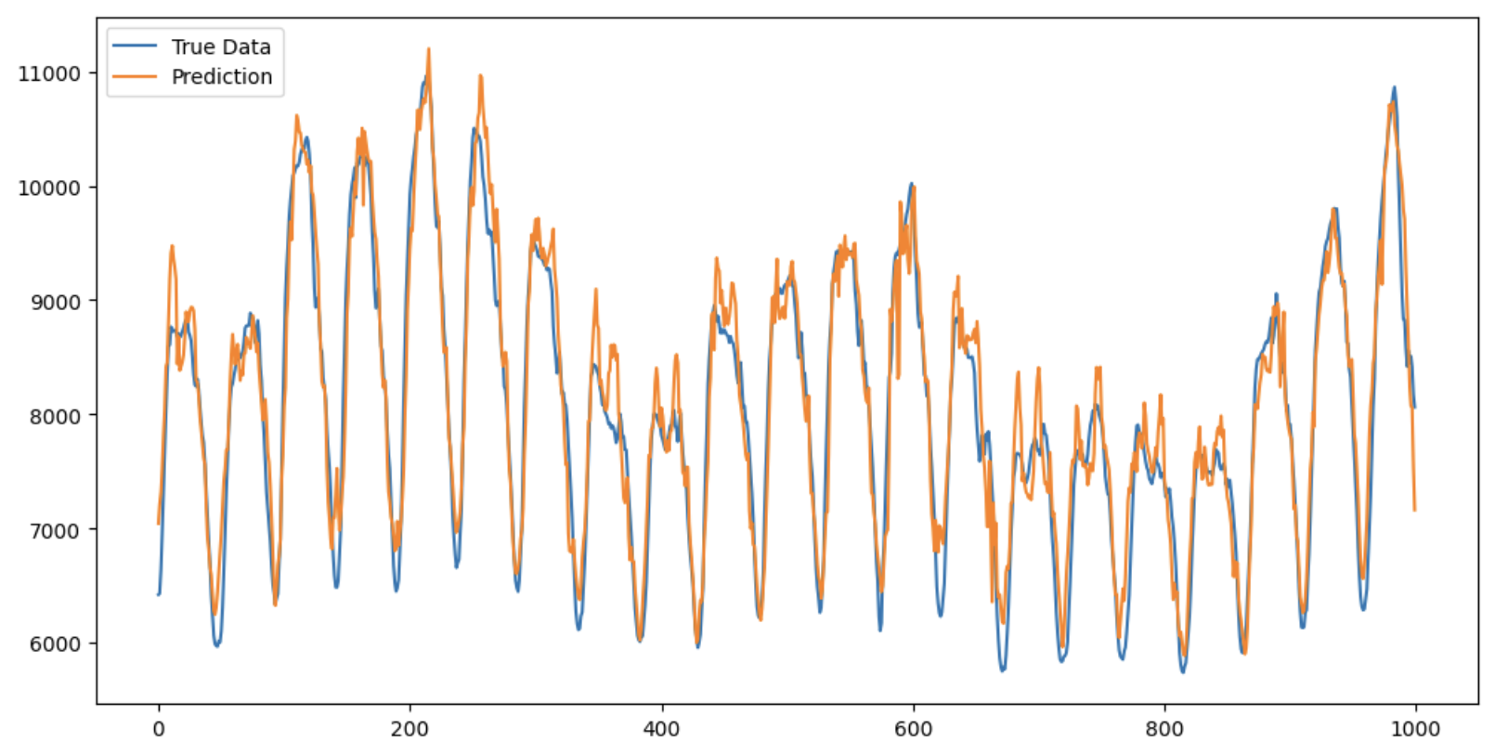
Comparison between different methods
RNN Model
LSTM Model
RNN
LSTM
WRNN
WLSTM

Slide 21

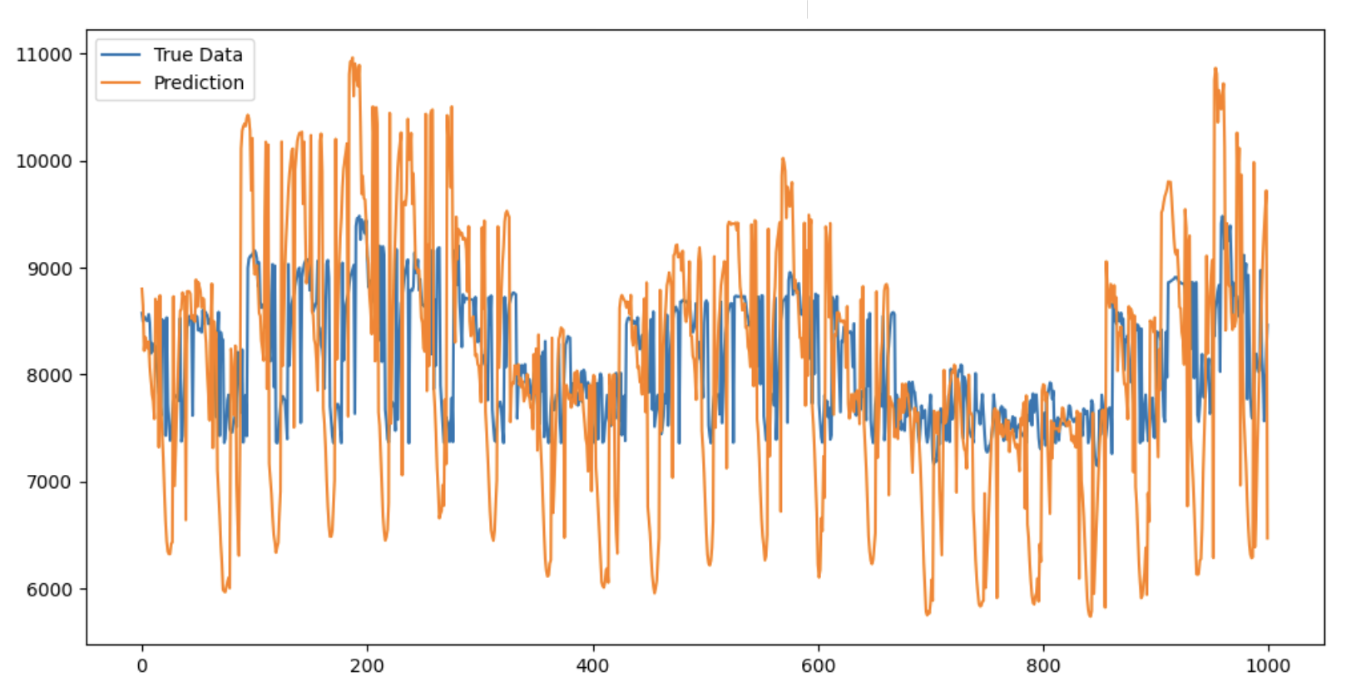
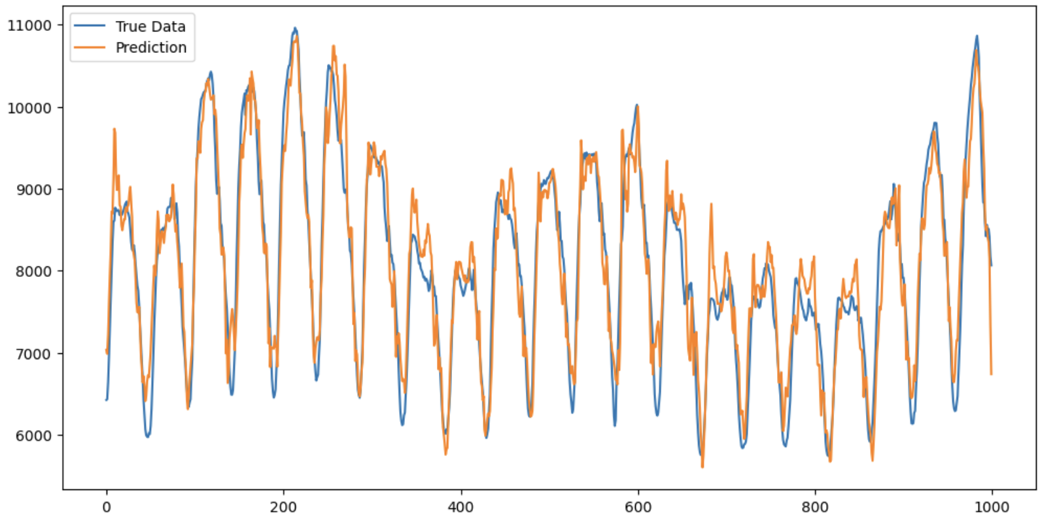
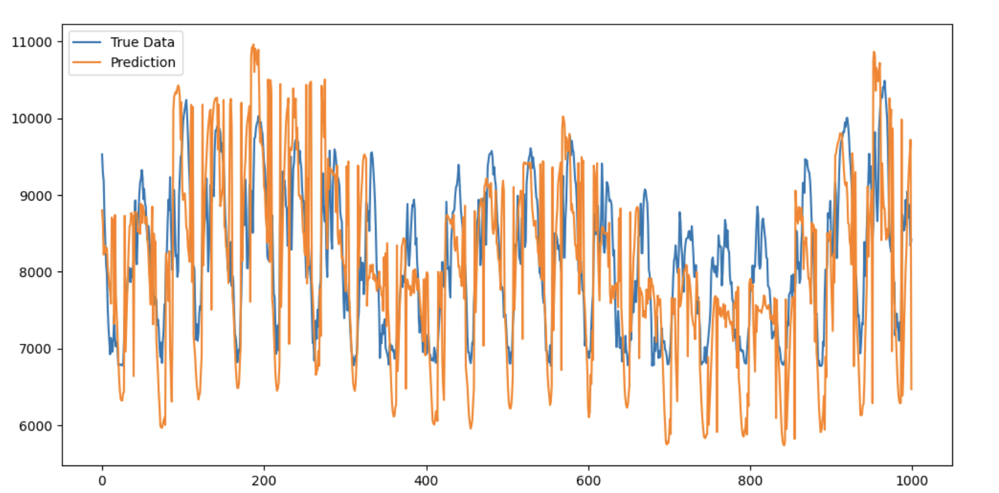
Comparison between different methods
GRU
Transformer
GRU
Transformer
WGRU
W-Transformer

Slide 22
Conclusion

Slide 23
Conclusion
Superior performance of mWDN-based models in forecasting tasks.
A significant advancement in frequency-aware deep learning models for time series analysis.
Demonstrated the effectiveness and interpretability of the proposed mWDN-based models.
Holds promise for improving accuracy and understanding in real-world time series applications.
Enables robust predictions for variation of forecasting horizons and any prediction sequence adjustments.

Slide 24
Future Works
Frequency-aware deep learning models open new avenues for time series analysis.
Potential applications in various domains such as finance, healthcare, and environmental monitoring.
Further research can explore additional interpretability techniques and optimize model performance.

